Slide 1

Mini Project Synopsis Presentation Job Portal
KIET Group Of Institutions ,(Delhi NCR),Ghaziabad
Department of Computer Application
Made By: Roll No:
Sudarshan Pandey 2100290140137
Arpit Gupta 2100290140037
Shivam Gupta 2100290140127
Prabhat Singh 2100290140102

Slide 2
Content
Team Details
Introduction
Hardware And Software Required
Module Description
Report/Output
Conclusion
How To Serve The Society
Gantt Chart

Slide 3
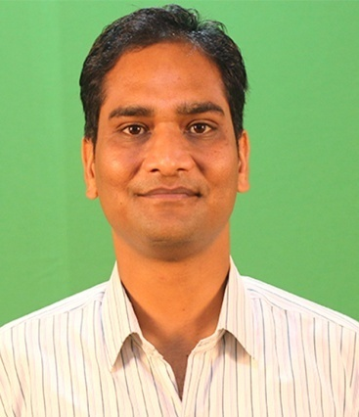
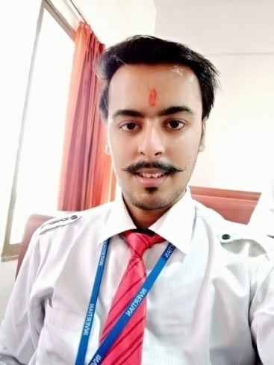

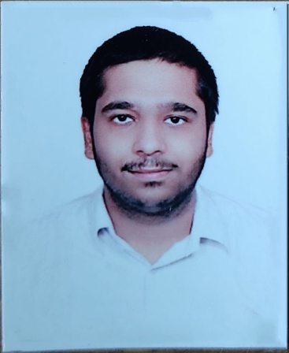

Team Detail
Mr. Ankit Verma
Asst. Professor
Project Supervisor
Sudarshan Pandey
Team Leader
MCA-III-C
Arpit Gupta
MCA-III-C
Team Member
Shivam Gupta
MCA-III-C
Team Member
Prabhat Singh
MCA-III-C
Team Member

Slide 4
Introduction
The aim of this project is to develop a Job Portal for the candidates who are jobseekers. The system is an online application that can be accessed through the web with proper login. This system manages the candidate information. Candidate should be able to fill their information by filling form on website. Visitors/Company representatives can, access/search any information put up by candidates.

Slide 5
Hardware and Software Required
HARDWARE REQUIREMENTS-:
1-Hardware
: Processor i3 or above
2-Clock speed
: 3.0 GHz
3-RAM size
: 4 GB or above
4-Hard Disk capacity
: 500 GB or above
5- Peripheral Devices
SOFTWARE REQUIREMENTS-:
1-Operating System-
: Linux, Windows(7,8,10) (any one)
2-Browser
: Google chrome or any other
3-Application software-
: Visual Studio Code
4-Server-
: Xampp
5-Documentation-
: MS-Office

Slide 6
Module Description
(a-) Job Seeker Module:
In jobseeker module candidate will be able to create his account on the portal.
Candidate will be able to enter his details and there will be option to upload the resume.
After successfully creating the account candidate will be able to view jobs and be able to apply for it.
Candidate can also be able to contact with company, if there is any issue

Slide 7
.
(b-) Company Module:
In company module, company will first create the account on the portal.
Then company will be able to upload the details of the job on the portal.
Afterward, when candidate will applied for the job, company will shortlist the candidate resume, for further process.

Slide 8
.
(c-) Admin Module :
The Admin will able to manage Signup/Login Modules.
Admin will be able to manage the candidate details.
This module will be able to manage company details and job details.
Admin will be able to get the report of the students who get the job or not.

Slide 9
Report/Output
The output of this project is that, if any registered candidate on the Job Portal who is eligible for the job and have applied for it, if the candidate have passed in all the rounds conducted by the company then the output will be as- candidate will get the job.
The portal will also generate a automatic report, in which we can see the details of the registered students who get a job or not.

Slide 10
Conclusion
It will be a great pleasure for us to work on this exciting and challenging project. This project will be prove good for us as it provide the practical knowledge of ASP.NET [web based application] and on SQL Server, but also about all handling procedure related with “Job Portal”.

Slide 11
How to serve the society
This project serve the society as, the candidates who are job-less and finding job offline but unable to get the job, So they have to simply register on the job portal and they can see ‘n’ number of jobs on the portal, according to their qualification they can apply for the job and if they pass all the round then they have won a Job.

Slide 12
Gantt Chart in terms of week
Task | Week | Week 2 | Week 3 | Week 4 | Week 5 | Week 6 | Week 7 | Week 8 | Week 9
Synopsis & PPT | done
Admin Module |  | In this week
Jobseeker Module |  |  | In this week
Company Module |  |  |  | In this week
Report Module |  |  |  |  | In this week
UI Design |  |  |  |  |  |  | In this week
Project Report |  |  |  |  |  |  |  | In this week | Final

